Slide 1

search and Sort algorithms

Slide 2
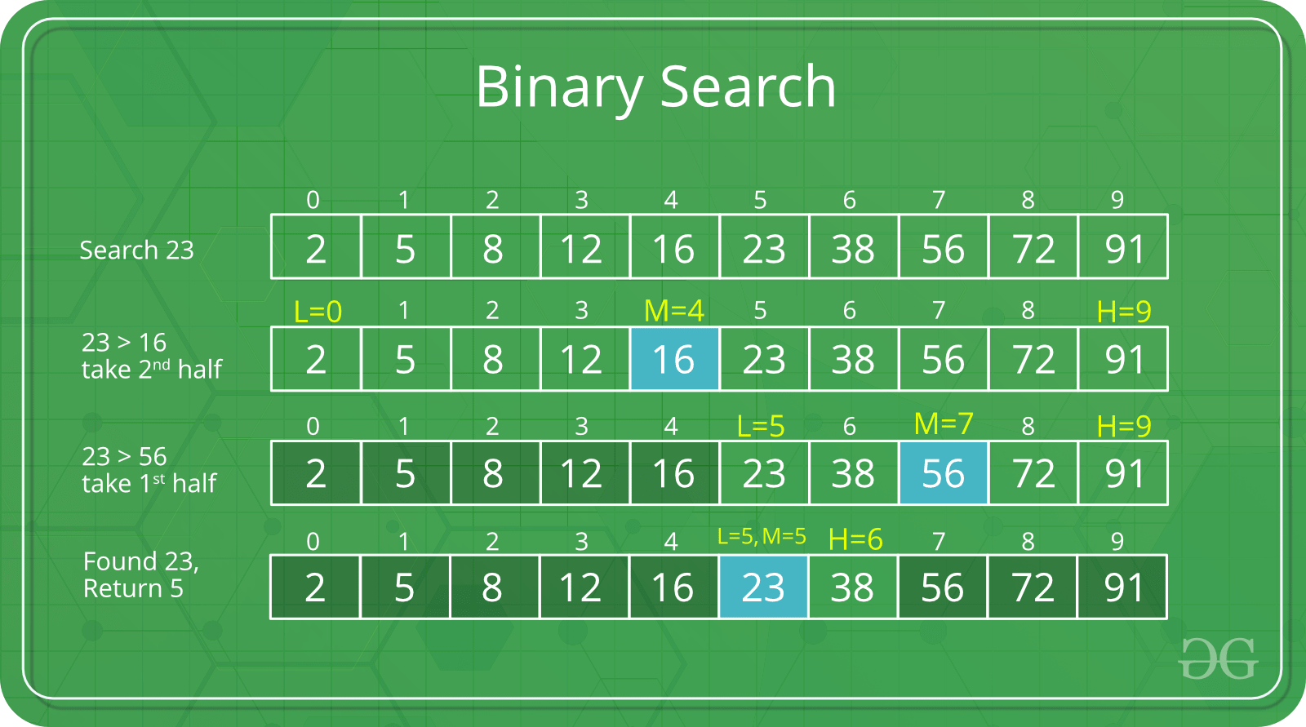
BINARY SEArCH ALGORITHM
Compare x with the middle element.
If x matches with middle element, we return the mid index.
Else If x is greater than the mid element, then x can only lie in right half subarray after the mid element. So we recur for right half.
Else (x is smaller) recur for the left half.

Slide 3
PROS
APPLICATIONS
The best case complexity is O(1).
Sorting linked lists without extra space.
Inversion Count Problem (how far or close the array is from being sorted)
Used in External Sorting

Slide 4
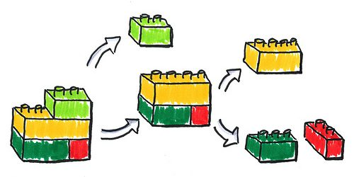
Merge Sort algorithm
Divide and Conquer
Step 1 − if it is only one element in the list it is already sorted, return.
Step 2 − divide the list recursively into two halves until it can no more be divided.
Step 3 − merge the smaller lists into new list in sorted order.

Slide 5
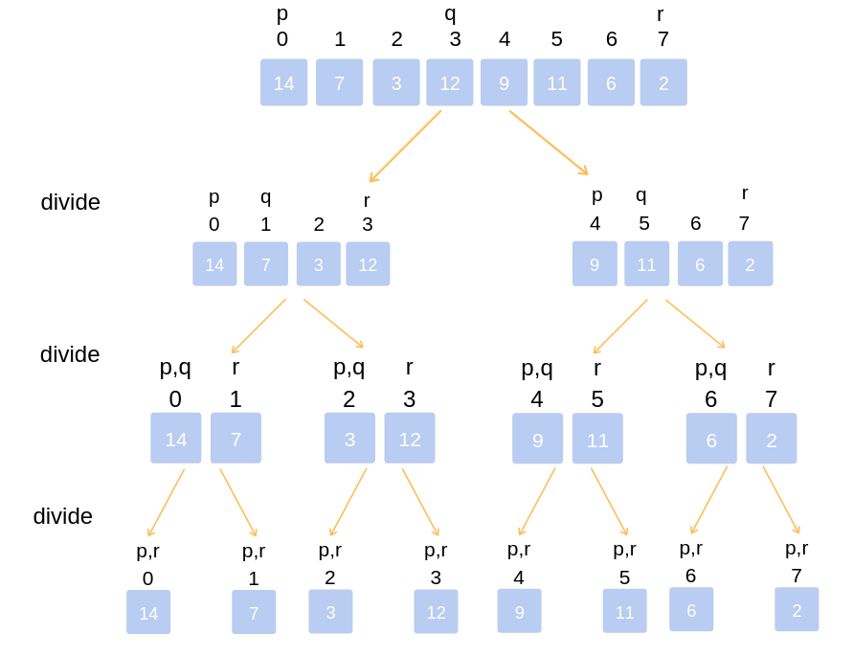

Slide 6
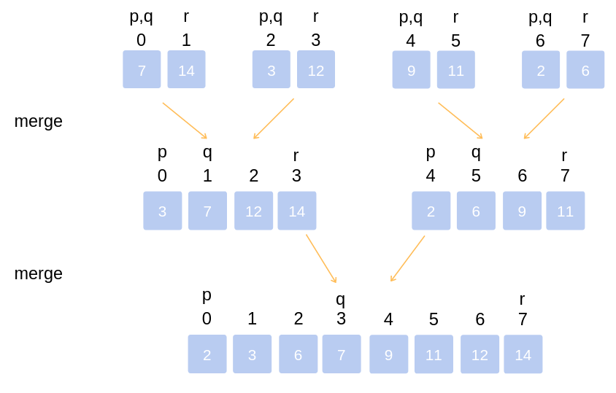

Slide 7
PROS
APPLICATIONS
Worst case , best case, average case time complexity is : o(n log(n)) which makes it very efficient .
It starts with smaller subfiles and finishes with largest ones . As a result it doesn’t need stack. Therefore this algorithm is stable.
Sorting linked lists without extra space.
Inversion Count Problem (how far or close the array is from being sorted)
Used in External Sorting

